Slide 1
08
01
05
09
02
07
03
04
06
ATLIQ MART
Data Analysis

Slide 2
01
02
03
04
05
06
07
08
09
ATLIQ MART
Data Analysis

Slide 3
01
02
03
04
05
06
07
08
09
Understanding Business Problem

Slide 4
01
02
03
04
05
06
07
08
09
Data Collection & Understanding

Slide 5
01
02
03
04
05
06
07
08
09
Data Modelling

Slide 6
01
02
03
04
05
06
07
08
09
Mock – Up Dashboard

Slide 7
01
02
03
04
05
06
07
08
09
Power BI – Order Insights

Slide 8
01
02
03
04
05
06
07
08
09
Power BI – Order Lines Insights

Slide 9
01
02
03
04
05
06
07
08
09
Power BI – Delay Analysis

Slide 10
01
02
03
04
05
06
07
08
09
Power BI – Key Trends

Slide 11
01
02
03
04
05
06
07
08
09
Power BI – Insights Summary

Slide 12

1
Understanding Business Problem
AtliQ Mart, a growing FMCG manufacturer headquartered in Gujarat, India, operational in Surat, Ahmedabad, and Vadodara, aims to expand to other metros/Tier 1 cities within the next 2 years.
The company is facing issues where key customers did not renew their annual contracts due to service issues, speculated to be caused by late or incomplete deliveries.
Management wants to resolve these service issues before expanding to new cities.
The Supply Chain team needs to track 'On-time' and 'In Full' delivery service levels daily to respond swiftly to these issues.
📊 Problem Statement
Measure ‘On-time delivery (OT) %’, ‘In-full delivery (IF) %’, and ‘On Time in full (OTIF) %’ of customer orders daily against target service levels.
Create a dashboard to monitor these metrics according to stakeholder requirements.
Provide relevant insights beyond the metrics list and stakeholder meeting requirements.
Objective
1

Slide 13


2
Data Collection & Understanding
Data Analyst
Data Analysis
2

Slide 14
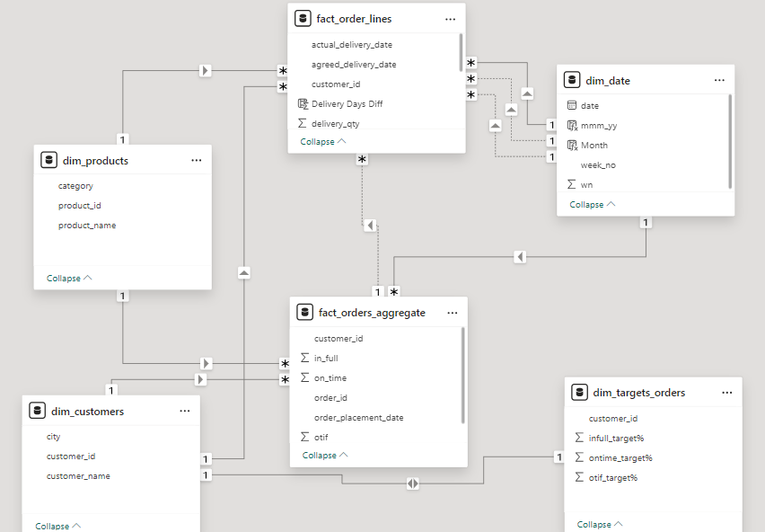
3
Data Modelling
Star Schema Data Modelling
3

Slide 15
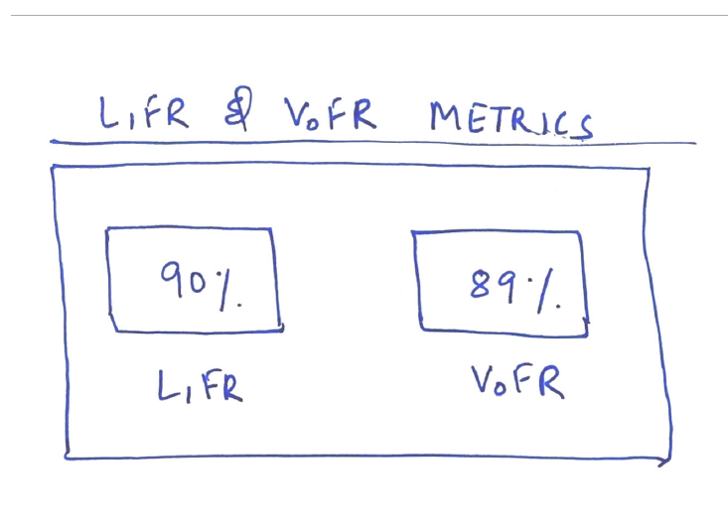
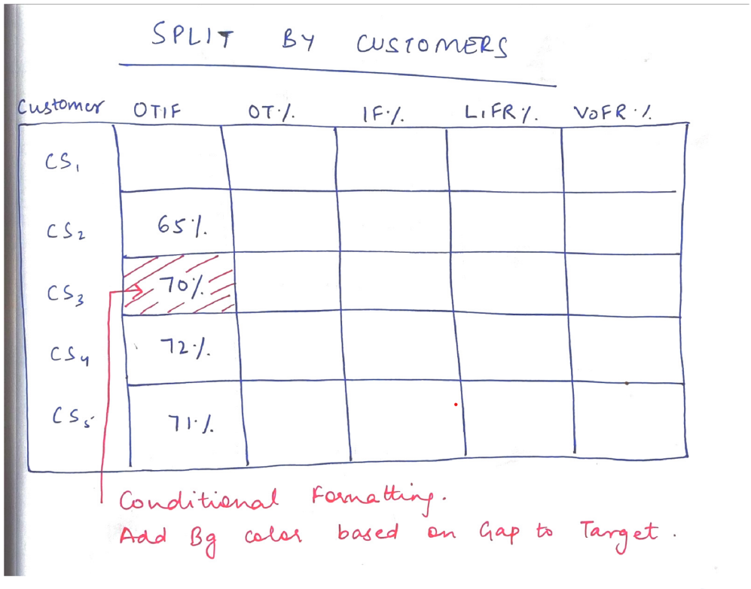
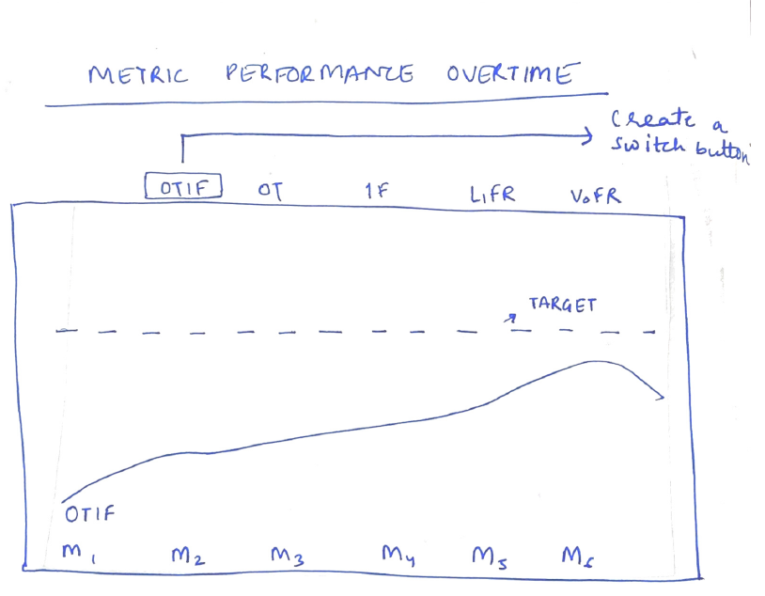
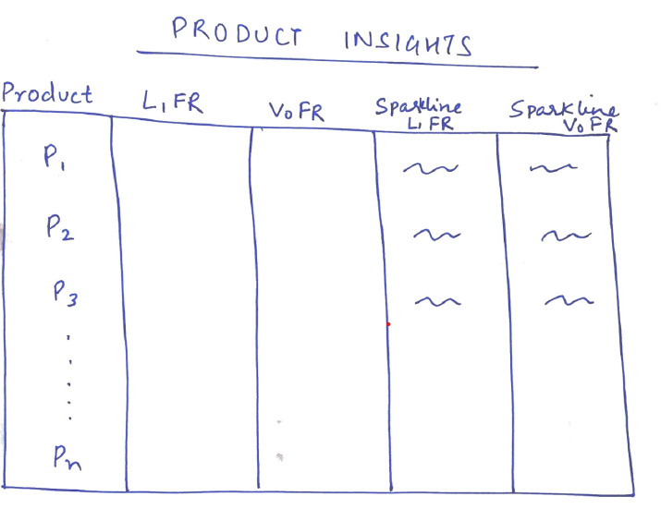
4
Mock – Up Dashboard
4

Slide 16
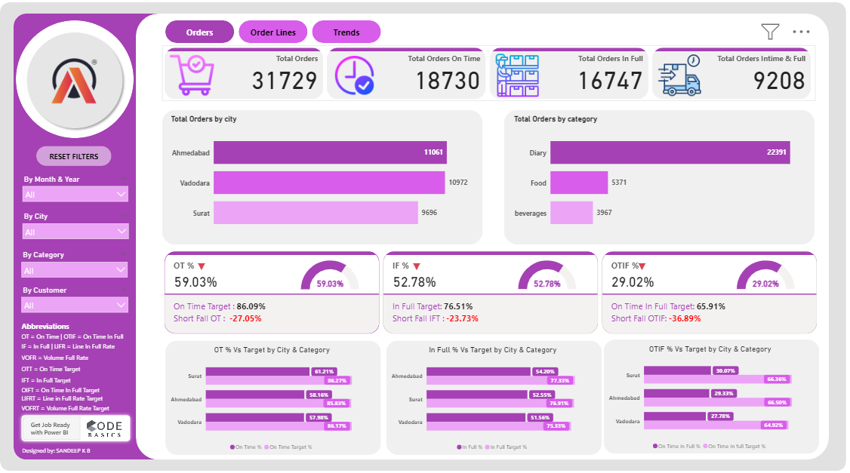
5
Power BI – Orders Insights
“Orders Insights” are mentioned below.
Total Orders: 31,729 orders.
On Time: 18,730 orders (59.03%)
In Full: 16,747 orders (52.78%).
On Time In Full (OTIF): 9,208 orders (29.02%).
Ahmedabad tops the list with 11061 orders followed by Vadodara and Surat with 10972 & 9696 orders, respectively.
Dairy products tops the list with 22391 orders followed by Food & Beverages with 5371 & 3967 orders, respectively.
City Performances vs (Target)
Surat: OT 61.21% Vs 86.27%, IF 52.55% Vs 76.91%, OTIF 30.07% Vs 66.36%.
Ahmedabad: OT 58.16% Vs 85.83%, IF 54.20% Vs 77.33%, OTIF 29.33% Vs 66.50%.
Vadodara: OT 57.98% Vs 86.17%, IF 51.56% Vs 75.33%, OTIF 27.78% Vs 64,92%.
5

Slide 17
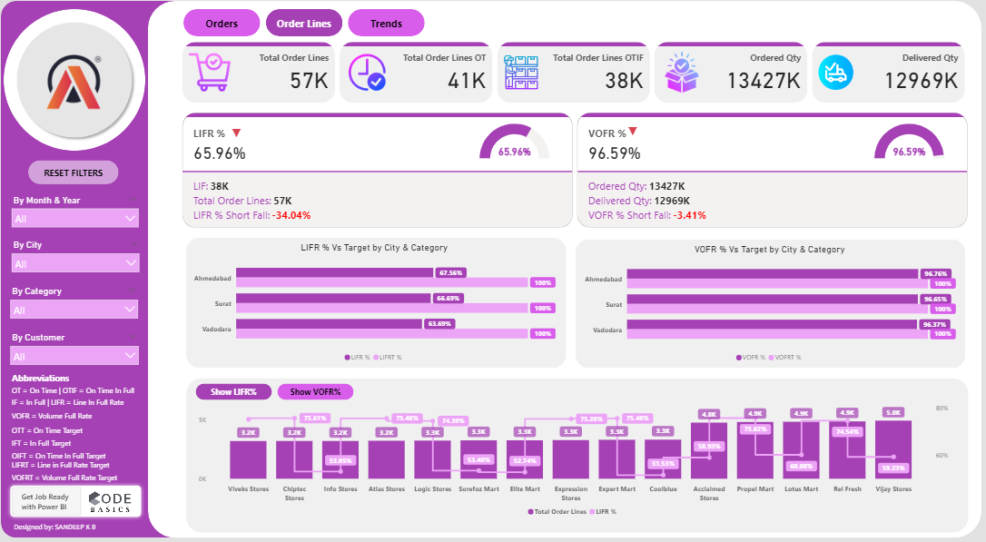
6
Power BI – Order Line Insights
“Order lines Insights” are mentioned below.
Total Order Lines: 57,096 lines.
On Time Order Lines (OT): 41,000 lines.
OTIF Order Lines: 38,000 lines.
Quantities:
Ordered Quantity: 13,427K units.
Delivered Quantity: 12,969K units.
Performance Metrics:
LIFR (Line In Full Rate): 65.96%, Shortfall: -34.04%.
VOFR (Volume Full Rate): 96.59%, Shortfall: -3.41%.
City Performances vs (Target)
Ahmedabad: IF 67.56% % Vs 100%, VOFR % 96.76% Vs 100%
Surat: IF 66.69% Vs 100%, VOFR % 96.65 % Vs 100%.
Vadodara: IF 63.69% Vs 100%, VOFR % 96.37 % Vs 100%.
6

Slide 18
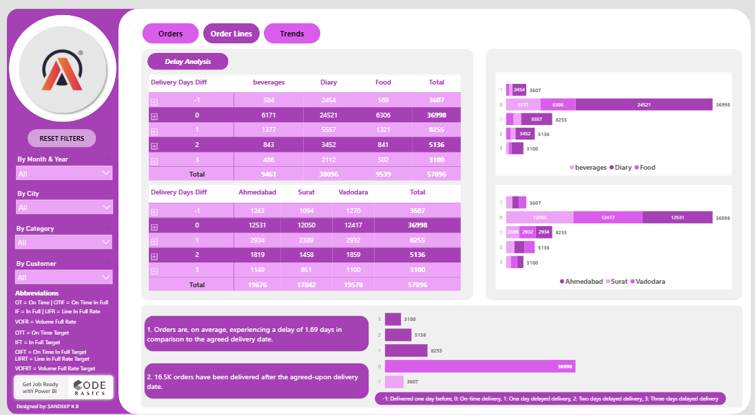
7
Power BI – Delay Analysis
“Delay Analysis on Order lines” are mentioned below.
Overall Delay Analysis:
Average Delay: Orders are, on average, experiencing a delay of 1.69 days compared to the agreed delivery date.
Delayed Orders: 16.5K orders have been delivered after the agreed-upon delivery date.
Delivery Performance by Category:
On-Time Delivery:
Beverages: 6,171 orders
Diary: 24,521 orders
Food: 6,306 orders
Delayed Deliveries:
One-day delay: 8,255 orders (with the highest delay in Diary category)
Two-day delay: 5,136 orders
Three-day delay: 3,100 orders
Contd………
7

Slide 19
7
Power BI – Delay Analysis
“Delay Analysis on Order lines” are mentioned below.
Delivery Performance by City:
On-Time Delivery:
Ahmedabad: 12,531 orders
Surat: 12,050 orders
Vadodara: 12,417 orders
Delayed Deliveries:
One-day delay:
Ahmedabad: 2,934 orders
Surat: 2,389 orders
Vadodara: 2,932 orders
Two-day delay:
Ahmedabad: 1,819 orders
Surat: 1,458 orders
Vadodara: 1,859 orders
Three-day delay:
Ahmedabad: 1,149 orders
Surat: 851 orders
Vadodara: 1,100 orders
Contd………
7

Slide 20
7
Power BI – Delay Analysis
“Delay Analysis on Order lines” are mentioned below.
Order Volumes:
Total orders by category:
Beverages: 9,461
Diary: 38,096
Food: 9,539
Total orders by city:
Ahmedabad: 19,676
Surat: 17,842
Vadodara: 19,578
Summary:
The largest volume of orders falls within the Diary category, with a significant proportion being delivered on time but also experiencing notable delays.
Ahmedabad has the highest number of total orders, but Surat and Vadodara show similar on-time and delayed delivery patterns.
The performance indicates room for improvement in reducing delivery delays, particularly focusing on mitigating one-day delays which are the most frequent.
7

Slide 21
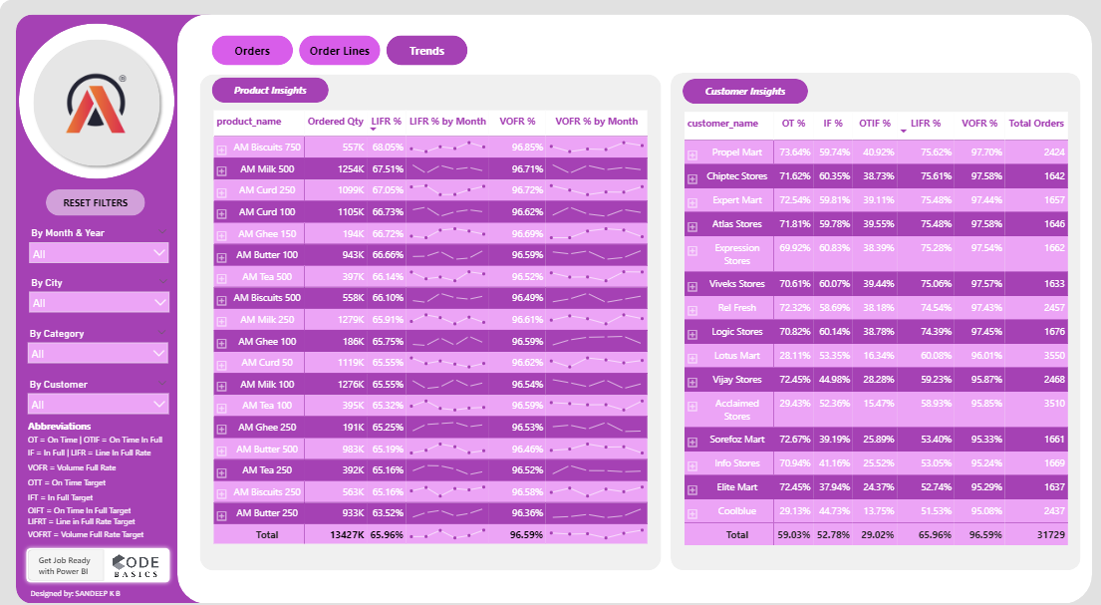
8
“Key Performance Trends” are mentioned below.
Overall, OT%: 59.03%.
Overall, IF%: 52.78%.
Overall, OTIF%: 29.02%.
Customer Insights:
Best Performing Customers:
Propel Mart: OT 73.64%, IF 59.74%, OTIF 40.92%, Total Orders: 2,424.
Chiptec Stores: OT 71.62%, IF 60.35%, OTIF 38.73%, Total Orders: 1,642.
Expert Mart: OT 72.54%, IF 59.81%, OTIF 39.11%, Total Orders: 1,657.
Worst Performing Customers:
Lotus Mart: OT 28.11%, IF 53.35%, OTIF 16.34%, Total Orders: 3,550.
Acclaimed Stores: OT 29.43%, IF 52.36%, OTIF 15.47%, Total Orders: 3,510.
Delivery Days Analysis:
Early Deliveries (-1 day): 3,607 orders.
On-Time Deliveries (0 days): 36,998 orders.
Delayed Deliveries:
1 day: 8,255 orders.
2 days: 5,136 orders.
3 days: 3,100 orders.
Power BI – Key Performance Trends
8

Slide 22
9
Power BI – AtliQ Insights Summary
The insights derived from the Power BI dashboard of AtliQ Mart's order and delivery performance highlight several critical areas for improvement. Here’s a detailed summary:
Orders Page Insights:
Total Orders: 31,729
On-Time Orders: 18,730 (59.03% on-time performance)
In-Full Orders: 16,747 (52.78% in-full performance)
On-Time In-Full (OTIF) Orders: 9,208 (29.02% OTIF performance)
Despite substantial order volumes, both on-time and in-full metrics fall significantly short of the targets, indicating inefficiencies in the order fulfillment process.
Order Lines Page Insights:
Total Order Lines: 57,096
On-Time Order Lines: 41,000
OTIF Order Lines: 38,000
Ordered vs. Delivered Quantity: 13,427K units ordered, 12,969K units delivered
Performance metrics:
Line In Full Rate (LIFR): 65.96%
Volume Full Rate (VOFR): 96.59%
The LIFR reveals a considerable gap between expectations and actual performance, suggesting issues in maintaining product availability and completeness in deliveries.
9

Slide 23
9
Power BI – AtliQ Insights Summary
Trends Page Insights:
Overall Performance: OT 59.03%, IF 52.78%, OTIF 29.02%
Customer Analysis:
Top Performers: Propel Mart (OT 73.64%, IF 59.74%, OTIF 40.92%)
Bottom Performers: Lotus Mart (OT 28.11%, IF 53.35%, OTIF 16.34%)
Delivery delays are a major concern, with an average delay of 1.69 days and 16.5K orders delivered late.
Delay Analysis Insights:
Delivery Days Difference:
Early (-1 day): 3,607 orders
On-Time (0 days): 36,998 orders
1 Day Late: 8,255 orders
2 Days Late: 5,136 orders
3 Days Late: 3,100 orders
By Product Categories:
Beverages: Mostly on-time, but notable delays of 1-3 days.
Dairy: Predominantly on-time, but significant delays on 1-2 days.
Food: Similar trend with fewer early deliveries and more delays.
By Cities:
Ahmedabad, Surat, Vadodara: Consistent with overall trends, with most orders on-time but substantial late deliveries.
9

Slide 24
9
Power BI – AtliQ Insights Summary
Key Takeaways:
Improvement Required in On-Time and In-Full Deliveries: The current on-time and in-full delivery rates are significantly below the targets. Focused efforts are needed to streamline processes and address bottlenecks.
High Volume of Late Deliveries: The average delay and the number of late deliveries suggest issues in logistics and supply chain management that need urgent attention.
City and Product-Specific Issues: Performance varies across cities and product categories, indicating the need for tailored strategies to address specific challenges in different areas.
Customer Satisfaction Impact: The variation in performance across different customers highlights the importance of consistent service levels to maintain customer satisfaction and loyalty.
Conclusion:
While AtliQ Mart handles a high volume of orders, significant improvements are needed in timely and complete deliveries to meet performance targets and enhance customer satisfaction. Addressing logistical challenges and optimizing the supply chain will be crucial to achieving these goals.
9

Slide 25
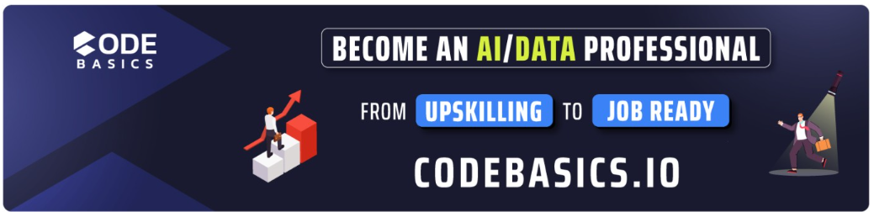



ATLIQ MART
Data Analysis
THANK YOU
Mr. DHAVAL PATEL
Mr. HEMANAND VADIVEL

Slide 26
08
01
05
09
02
07
03
04
06
ATLIQ MART
Data Analysis

